Slide 1

GOOD CABS Transportation and Mobility
FUNCTION –OPERATIONS
-PREPARED BY RUSHIKESH SHINDE

Slide 2
ABOUT GOODCABS
GoodCabs is a cab service company established two years ago that has gained a strong foothold in the Indian market by focusing on tier-2 cities.
PROBLEM STATEMENT
GoodCabs faces the challenge of expanding and scaling its operations while maintaining high standards of service in tier-2 cities. The company aims to enhance its growth in these markets, meet ambitious performance targets for 2024, and continue improving passenger satisfaction. It must also ensure that the drivers it supports are able to sustain a livelihood while providing consistent, high-quality service to customers.

Slide 3
TASK
GoodCabs management team aims to assess the company's performance across key metrics, including trip volume, passenger satisfaction, repeat passenger rate, trip distribution, and the balance between new and repeat passengers.
INPUTS PROVIDED
Data sets and Problem statement
Primary and secondary questions.
Business Requests

Slide 4
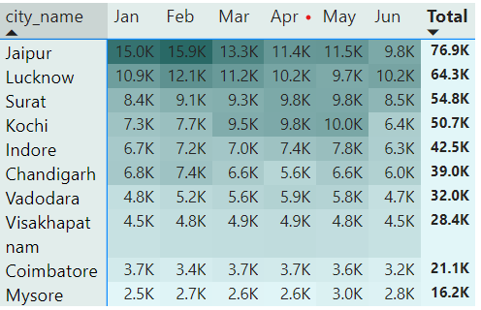
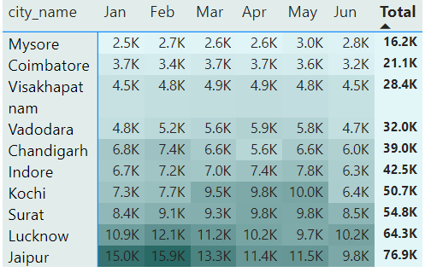
DATA ANALYSIS
1.Top and Bottom Performing cities
Identify the top 3 and bottom 3 citites by total trips over the entire analysis period
💡INSIGHTS
Top 3 cities -Jaipur , Lucknow, Surat has contributed the highest number of trips
Bottom 3 cities -Mysore, Coimbatore and Visakhapatnam has noted lowest number of trips Top 3 cities

Slide 5
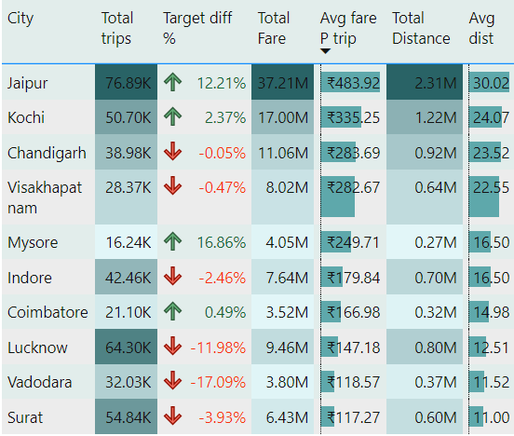
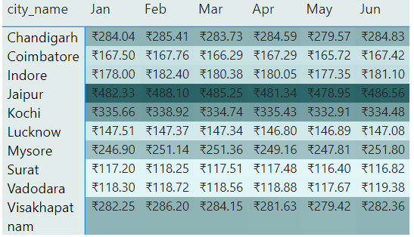
DATA ANALYSIS
2. Average Fare Per Trip by city
Calculate the avg fare per trip for each city and compare it with the city’s avg trip distance. identify the cities with the highest and lowest avg fare per trip to assess pricing efficiency across location
💡INSIGHTS
Highest Average Fare Amount -Jaipure(483.92) has the highest average fare Amount and avg distance travelled is 16.12km
Lowest Fare amount - Surat (117.27) has the lowest fare per trip and the distance travelled is 10.66km
Note- the average fare price depends on the distance travelled if the distance is less the price is comparatively low

Slide 6
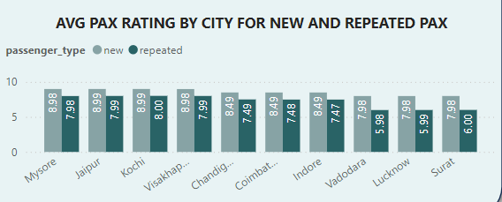
DATA ANALYSIS
3. Average Rating by city and passenger type
a. Calculate the avg passenger and driver ratings for each city, segmented by passenger type b. identify cities with highest and lowest avg ratings
Highest and lowest rated cities BY new passengers –
Highest rating - 8.9 Jaipur, kochi ,Mysore , Visakhapatnam are the cities with highest rating indicating the good service Low rating -<8 Lucknow,Surat and Vadodara may be due to poor service
Highest and lowest rated cities BY Repeated passengers - Highest rating -According to the visitors Visakhapatnam is the cities with highest rating indicating the only one good service Provider Low rating – Surat,Lucknow and Vadodara remains the same for repeated passenger as well

Slide 7
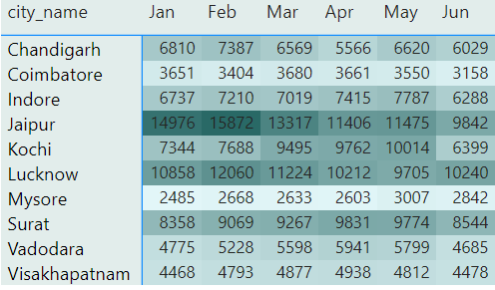
DATA ANALYSIS
4. Peak and Low Demand Months by city
Highest demand month and city Identify the city and month with highest and lowest demand by total trips
💡INSIGHTS
February is the busiest month with the highest demand of trips to the city Jaipur , Lucknow,Surat and Chandigarh by goodcabs
Lowest demand month and city -January is the month with the least demand of trips to the city Mysore , Visakhapatnam .

Slide 8
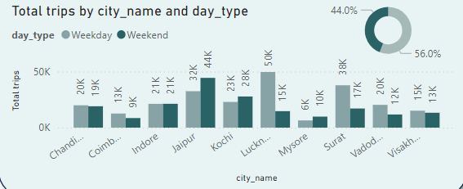
DATA ANALYSIS
5. Weekend Vs Weekday trip demand by city
Compare the total trips taken on weekdays vs weekends for each city over the 6 month period.
b. identify cities with strong preference for either weekend or weekday trips to understand demand variations
💡INSIGHTS
Nearly 44 % of trips were taken on weekends and 56% on weekdays , it is noticed that there is highest demand of cabs on weekdays .
b. Torisum focused cities like Jaipur, Kochi, indore and mysore has strong preference on weekends and Bussiness focused cities like Lucknow, Surat has stonge preference on weekdays

Slide 9
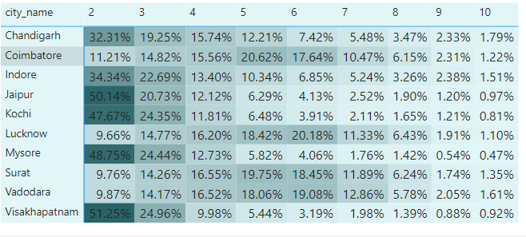
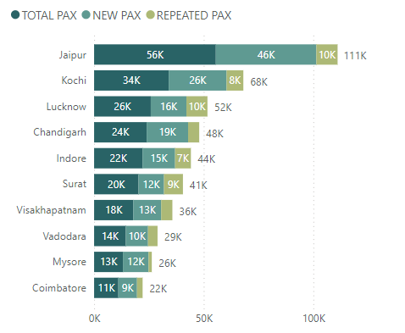
DATA ANALYSIS
6.Repeat passenger frequency and city contribution analysis
Identify which cities contribute most to higher frequencies among repeat passengers
💡INSIGHTS
Tourism focused - cities like Jaipur, Mysore, Visakhapatnam seems to have higher frequency of 2 trip-visits.
Business focused -cities like Surat, Lucknow, Vadodara, and Coimbatore. has repeated passenger visits ranging from 4 to 6 trips, driven by business and industrial travels

Slide 10
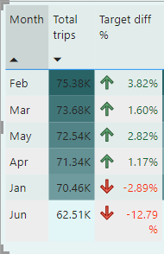
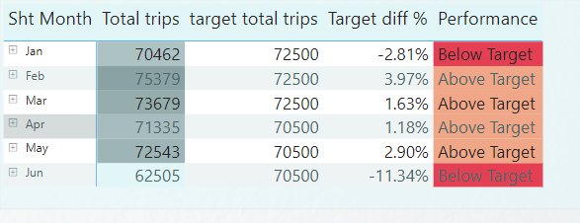
DATA ANALYSIS
7a. Monthly target achievement analysis for key metrics
Evaluate monthly performance against target for total trips
💡INSIGHTS OUTPUT
January - has not meet the target this may be due to post holiday period after December.
June - also not meet the target this may be due Seasonal Fluctuation

Slide 11
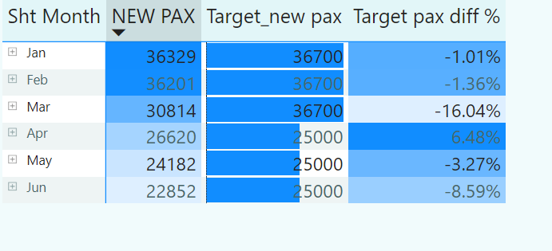
DATA ANALYSIS
7b. Monthly target achievement analysis for key metrics
Evaluate monthly performance against target for new passengers
💡INSIGHTS OUTPUT
April is the only month that has exceeded the target for new passenger that indicates that there was a significant increase in the number of first time users during this month this should be worked and replicated in other months as well.

Slide 12
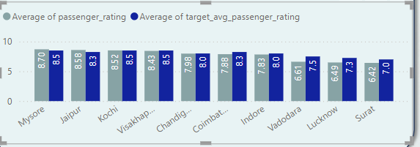
DATA ANALYSIS
7c. Monthly target achievement analysis for key metrics
Evaluate monthly performance against target for average passenger ratings
💡INSIGHTS OUTPUT
Mysore, Jaipure and Kochi have successfully met the passenger rating target on GoodCab service. indicating the strong demand for cabs in Tourisumfocused cities

Slide 13
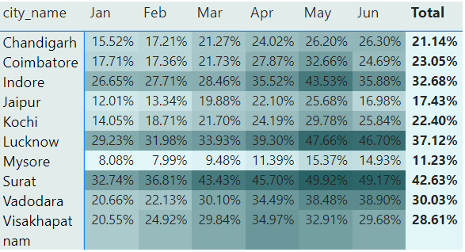
DATA ANALYSIS
8a. Highest and Lowest Repeat Passenger Rate(RPR%) by city
Identify top 2 and bottom 2 cities based on their RPR% for each cities
💡INSIGHTS
Top 2 citites (RPR%)- Surat Lucknow
Bottom 2 Cities (RPR%)- Jaipure mysore.

Slide 14
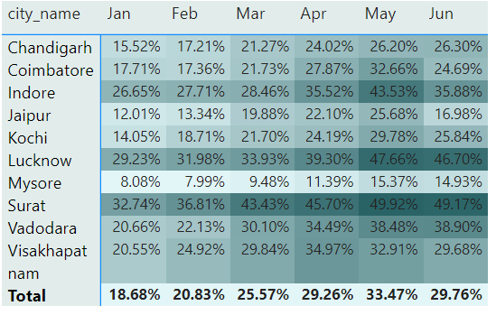
DATA ANALYSIS
8b. Highest and Lowest Repeat Passenger Rate(RPR%) by Month
Identify top 2 and bottom 2 cities based on their RPR% for each cities
INSIGHTS
April,may,june has highest RPR% may be due to increased trip during summer vacations Jan Feb and march has Low RPR% may be due to Post holiday period after december.

Slide 15
Recommendations to improve Trip bookings
offer discounts and driver incentives Provide targeted promotions and discounts to attract passengers, and offer incentives for drivers to work in low-demand cities, ensuring ride availability and service consistency.
Boost Local Awareness and Marketing: Run localized campaigns to raise awareness of GoodCabs in these cities, highlighting benefits and building customer loyalty through excellent service and personalized experiences.
Recommendations to improve Passenger Ratings
Offer tailored experiences for repeat passengers, such as preferred drivers or customized ride options, to make them feel valued and improve satisfaction.
Implement or enhance loyalty programs with benefits like discounts or exclusive offers to encourage repeat passengers and improve their overall experience.
Recommendations to improve Repeated Passenger
Collaborate with local factories and businesses to create dedicated cab services for their employees, offering scheduled pick-ups and drop-offs during shift changes. This can ensure steady demand and better ride availability.
Provide corporate discounts or loyalty programs for businesses, encouraging frequent use of GoodCabs by employees in industrial zones.

Slide 16
DASHBOARD

Slide 17
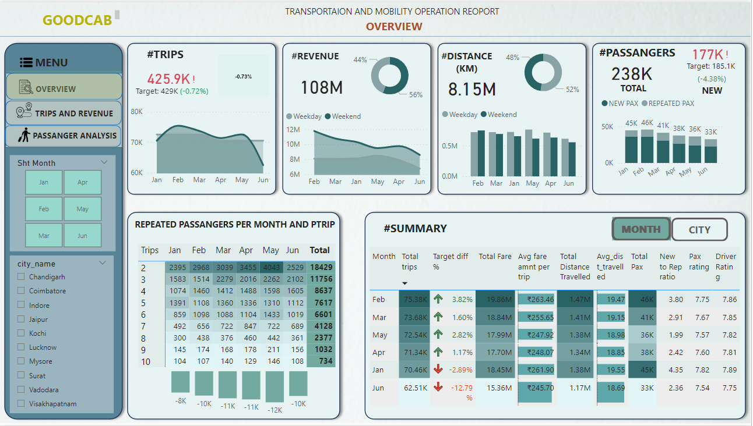

Slide 18
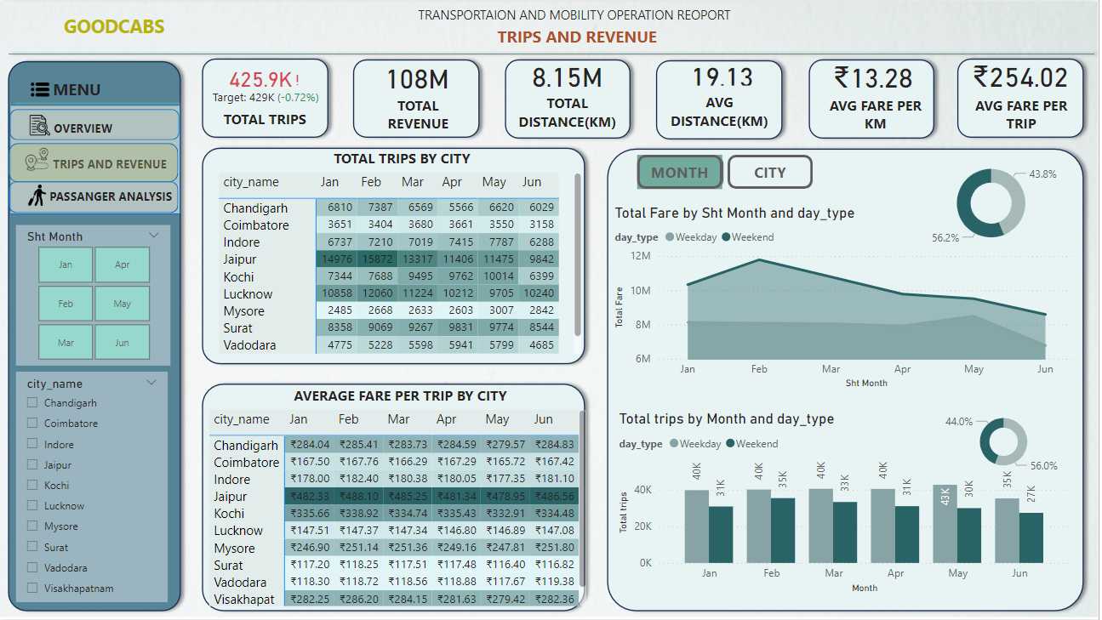

Slide 19
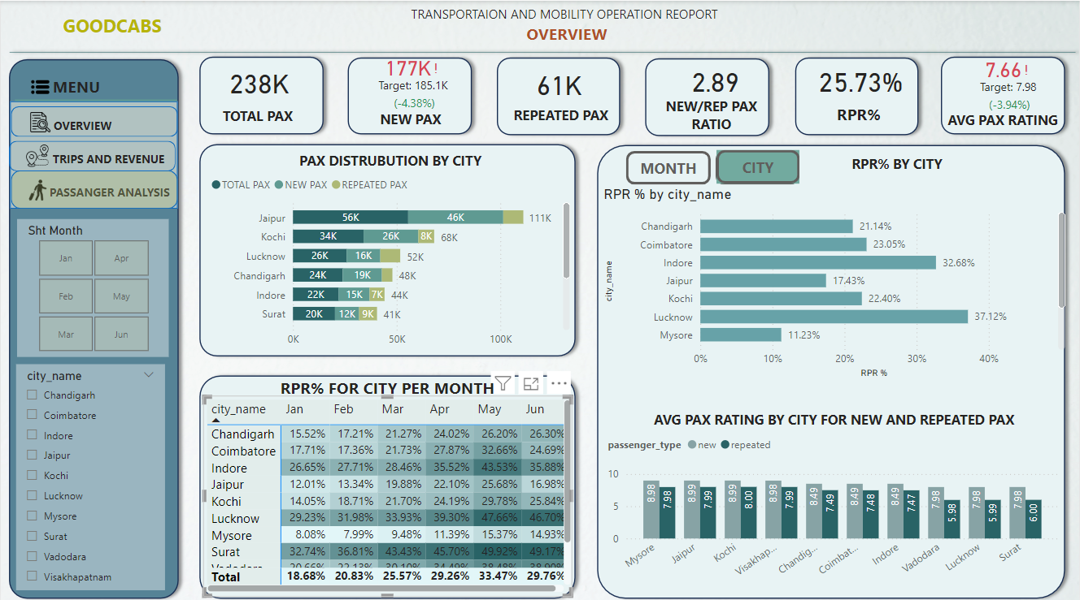

Slide 20
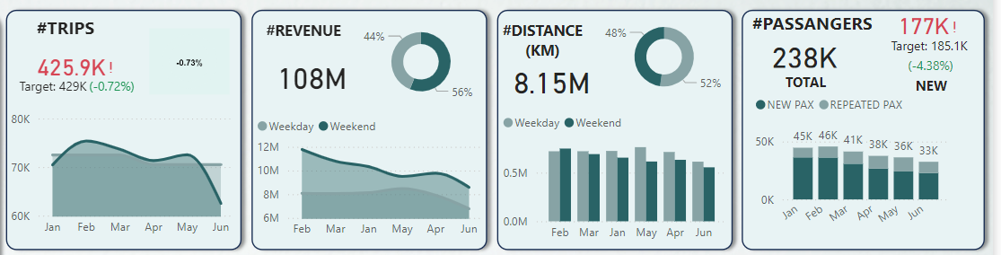
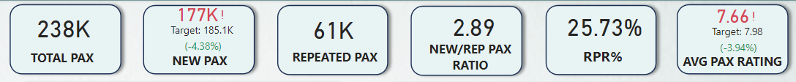
KEY METRICS

Slide 21
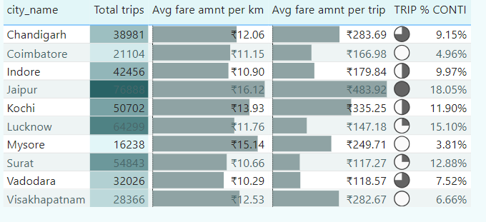
City-Level fare and Trip summary report
Generate a report that displays the total trips, average fare per km, avg fare per trip and percentage contributipn of each city’s trip to the overall trips. this report will help in assessing trip volume, pricing effeciency and each city’s contribution to the overall trip count
High demand and pricing : Cities with higher trip demand have higher fare prices and longer distances, indicating that demand drives both pricing and travel requirements.
City contribution : high - demand cities are critical to the company's over all performance ,contributing significantly to total trip and revenue.
Low trip cities- as it is seen that Visakhapatnam, Coimbatore and Mysore has low contribution of trips and has high fare price .
Solution- To improve these use route optimization to reduce travel distances and low cost by introducing targeted promotion's and dynamic pricing to services more affordable and attractive. offer incentives like first- ride free or referral programs to increase trip contribution in underperforming cities.

Slide 22
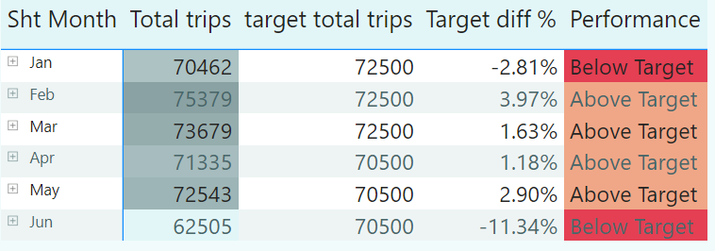
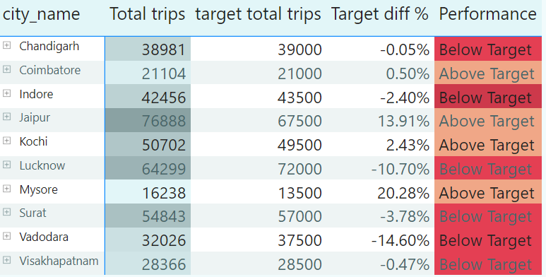
Monthly city level trips target performance report
Generate a report that evaluate the target performance for trips at the monthly and city level. Compare the actual total trip with target trips and categories the performance as if actual trip are greater than the target trip the “Above target ” else “Below target”
Recommendation to improve Trips - To improve trips in cities that have missed their targets, a combination of targeted marketing, dynamic pricing, increased availability, and local partnerships should be used. By analyzing the underlying causes of underperformance and implementing city-specific solutions, Good Cabs can improve performance and reach targets more effectively.

Slide 23
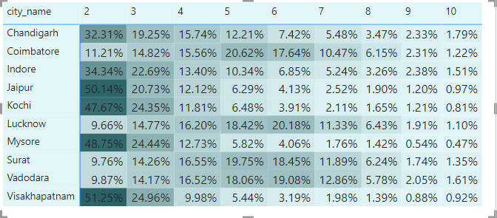
City-Level Repeat passenger trip frequency report
Calculate the percentage of repeat passengers who took 2 trip, 3 trip and so on ,upto 10trips
Tourist Focused cities
(e.g Jaipur, Kochi, Mysore) Likely see Lower repeat trio frequency (2-3 trips) due to short- term visits and varied usage (sightseeing, short - term travel ).
Recommendation - introduce tourist- focused programs like “Buy 2 rides, get 1 free” and special city packages to increase repeat usage and trip frequency.
Enhance ride availability by ensuring high ride availability at key tourist location and to improve the visibility make partnership with hotels.
Business Focused cities (e.g -Lucknow , Surat , Vadodara and Coimbatore) See higher repeat trip frequency (4-7 trips) due to longer stays and consistent need for transportation for work- related purposes.

Slide 24
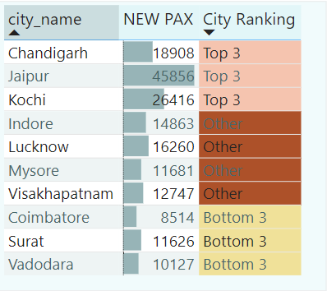
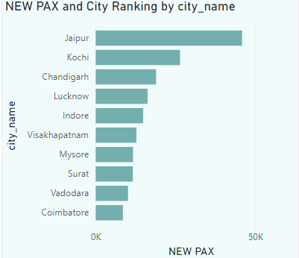
Identify citites with Highest and Lowest Total new passengers
Generate a report that calculate the total new passengers for each city and rank them based on theis value.identify the top 3 citites with the highest number of new passengers as well as the bottom 3 cities with lowest number of new passenger , categorising them as top 3 and bottom e accordingly
Recommendation to improve new passengers By offering attractive promotions, using targeted marketing, ensuring a smooth onboarding experience, and partnering with local businesses , Good Cabs can effectively attract new passengers. Ensuring service availability (24/7 service) in key locations will help convert potential customers into regular users

Slide 25
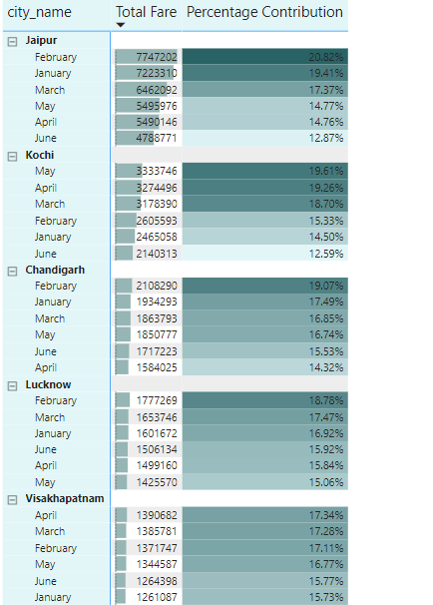
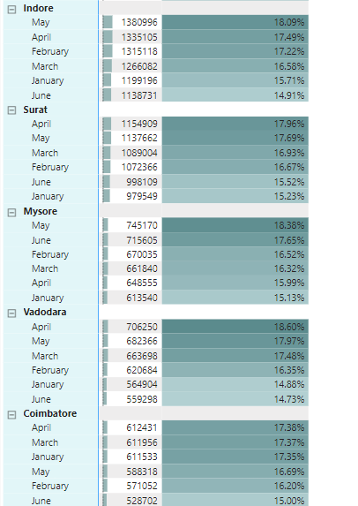
Identify month with Highest Revenue for each city
Generate a report that identifies that month with the highest revenue for each city . for each city , display month_name , the revenue amount for that month and the percentage contribution of that months revenue to cities total revenue

Slide 26
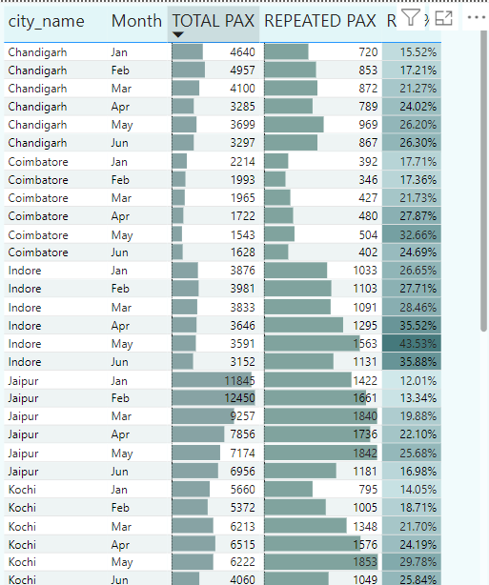
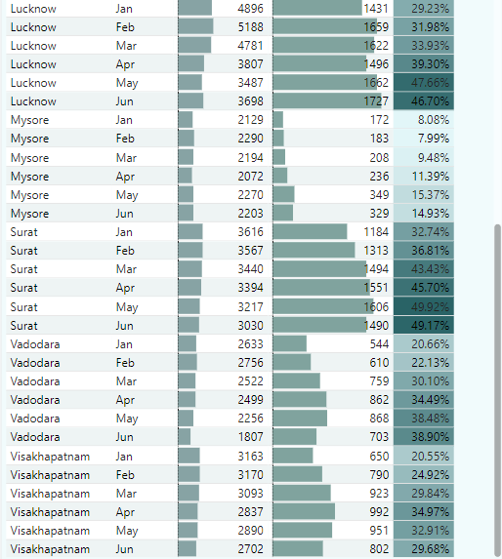
Repeat Passenger Rate Analysis
Generate a reprot that identifies Repeat passenger rate by Month level and city level

Slide 27
THANK YOU

